Slide 1
Machine Learning
Unit – 1 – [Part 2]
Supervised Learning

Slide 2
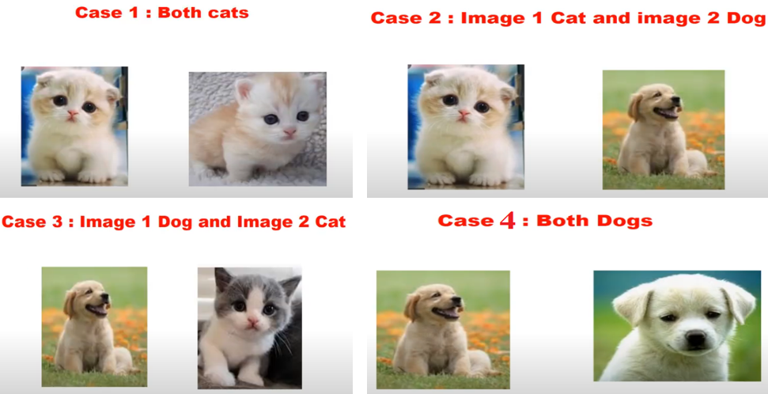
VC-dimension (Vapnik-Chervonenkis dimension)

Slide 3
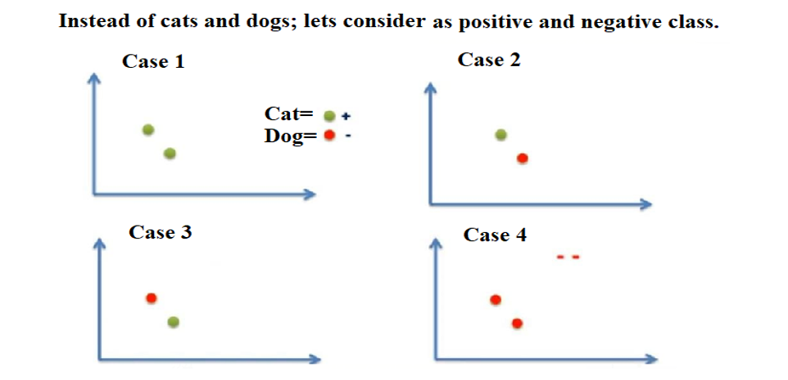

Slide 4
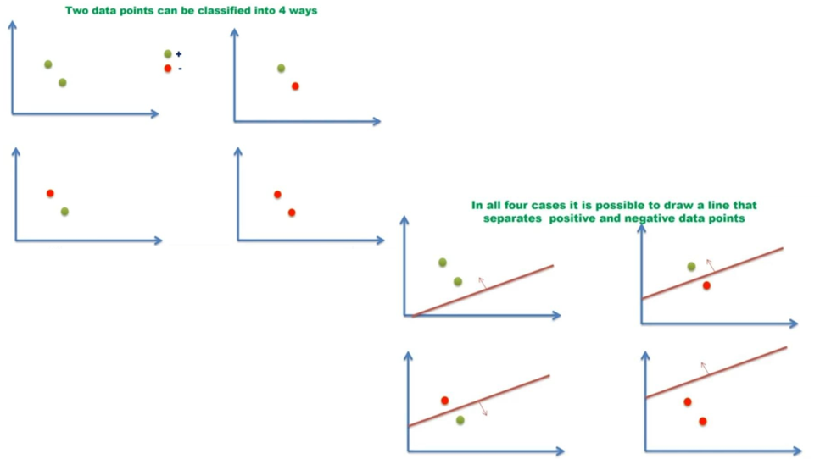

Slide 5
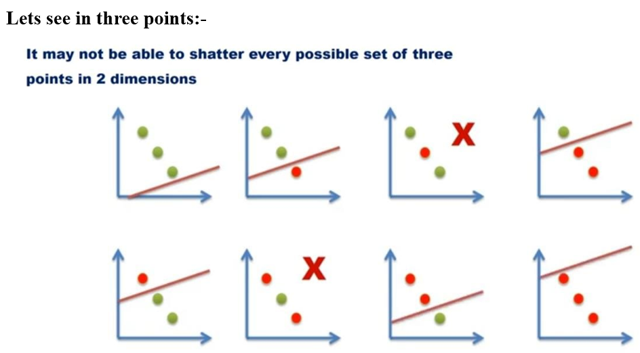

Slide 6
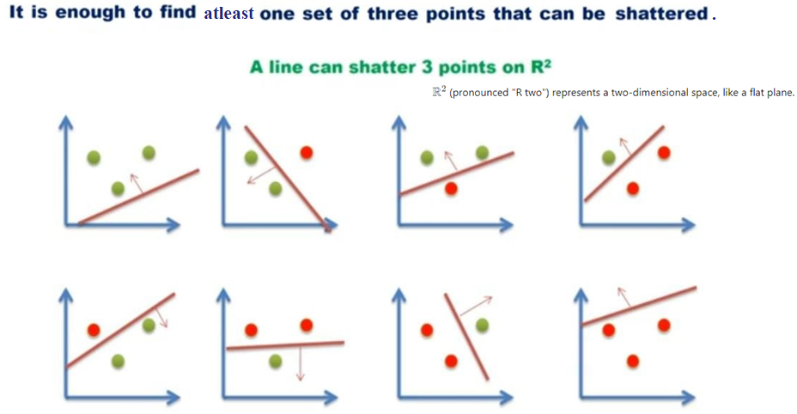

Slide 7
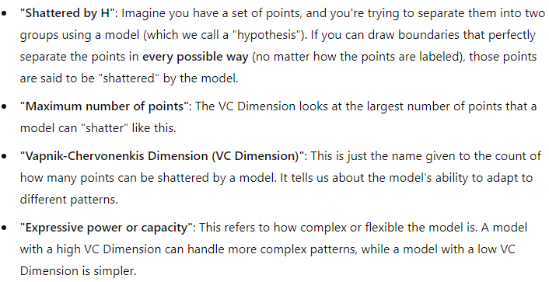
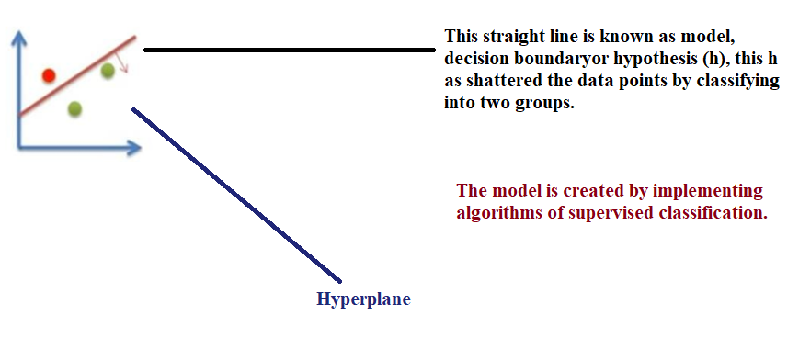

Slide 8

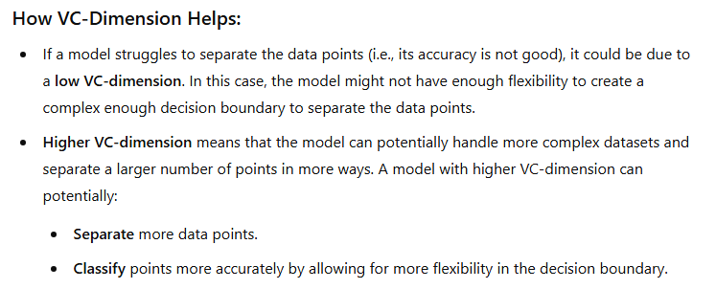
VC Dimension is a way of measuring how powerful a model is.
If a model can handle and correctly separate a large number of points in any possible arrangement, it has a high VC Dimension, meaning it’s very flexible.
If it can only do this for a few points, it has a lower VC Dimension, meaning it’s simpler and less flexible.

Slide 9
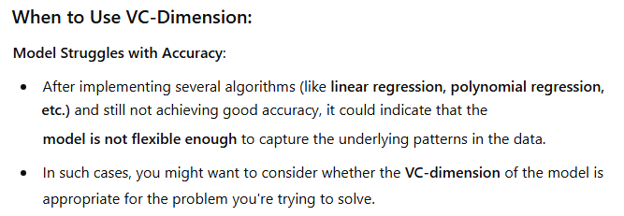


Slide 10
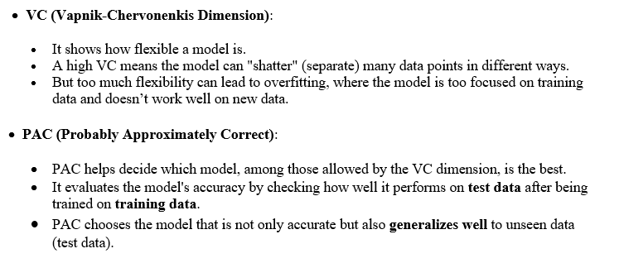
Probably Approximately Correct (PAC)

Slide 11
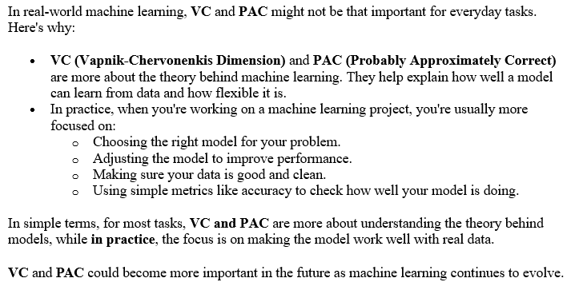

Slide 12
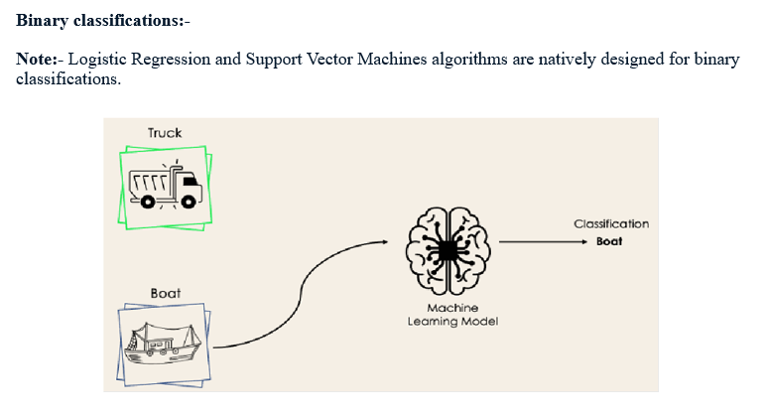
Learning Multiple Classes

Slide 13
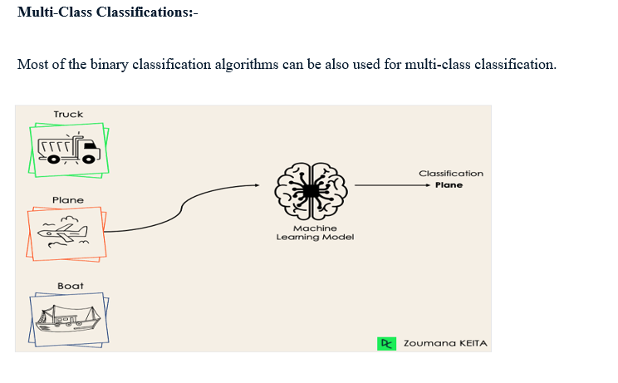

Slide 14
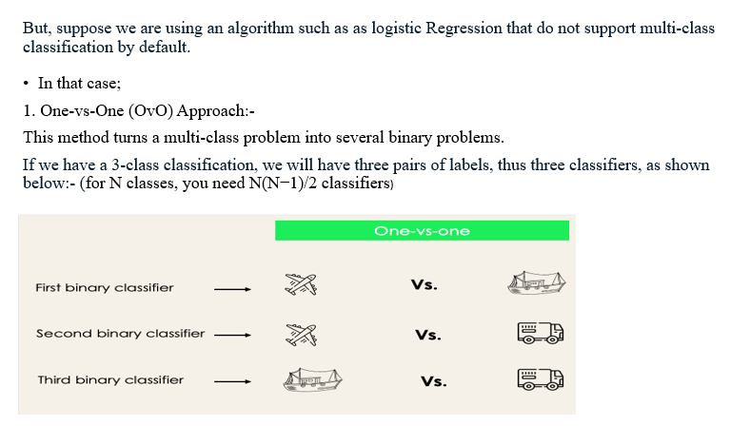

Slide 15
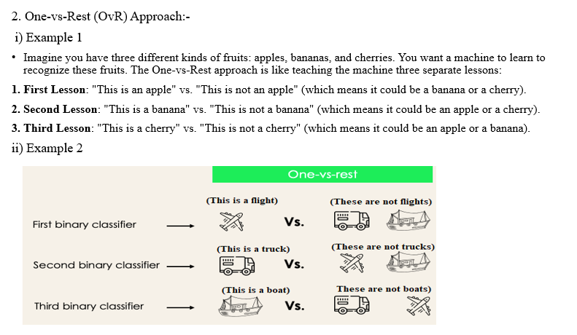

Slide 16
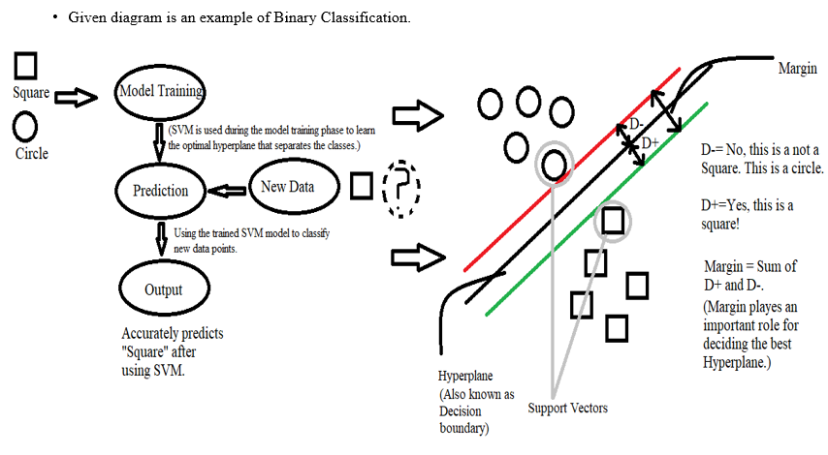

Slide 17
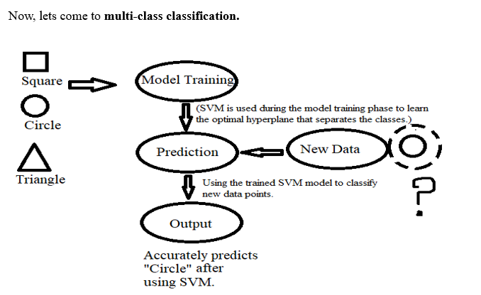

Slide 18
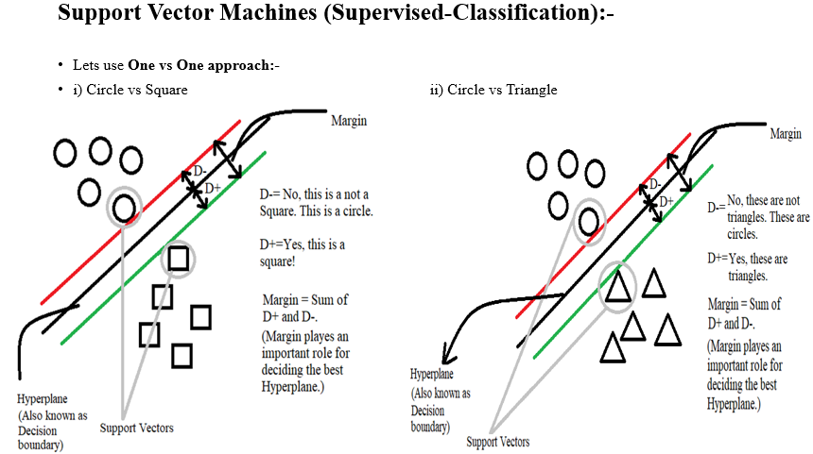

Slide 19
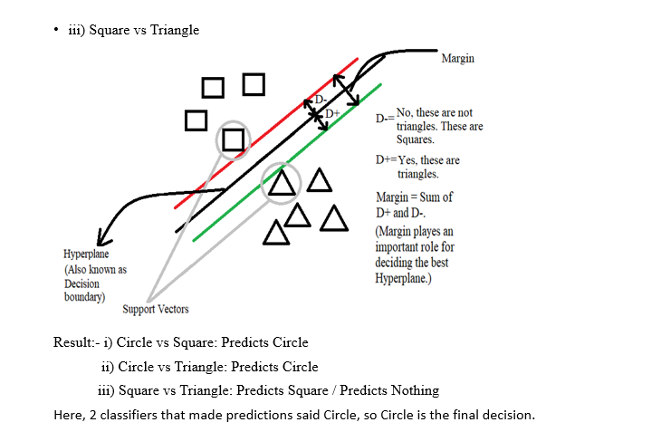

Slide 20
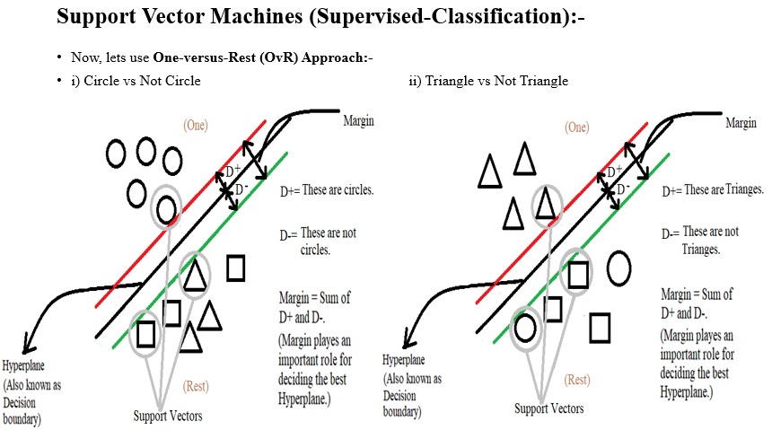

Slide 21
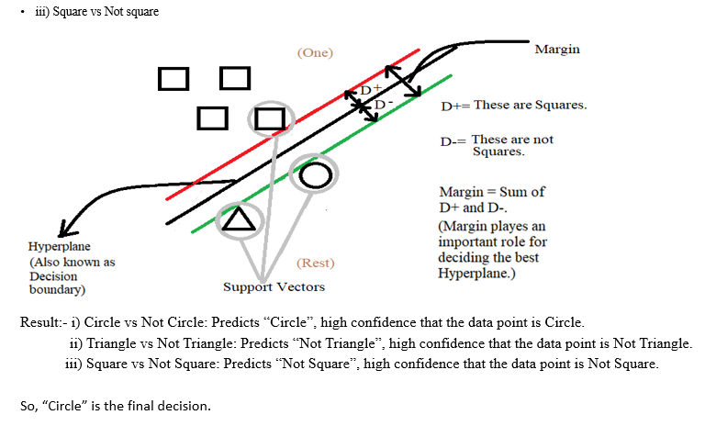

Slide 22
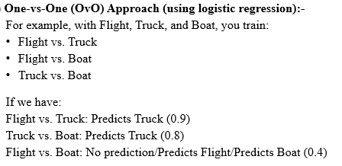

Slide 23
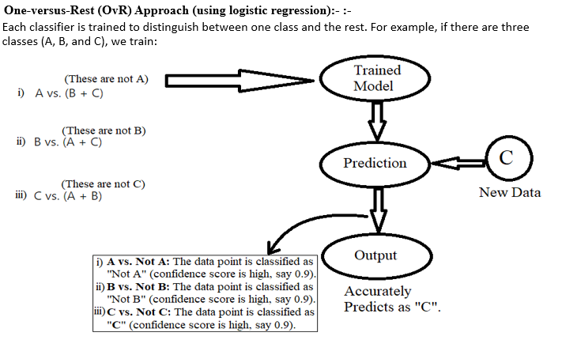

Slide 24
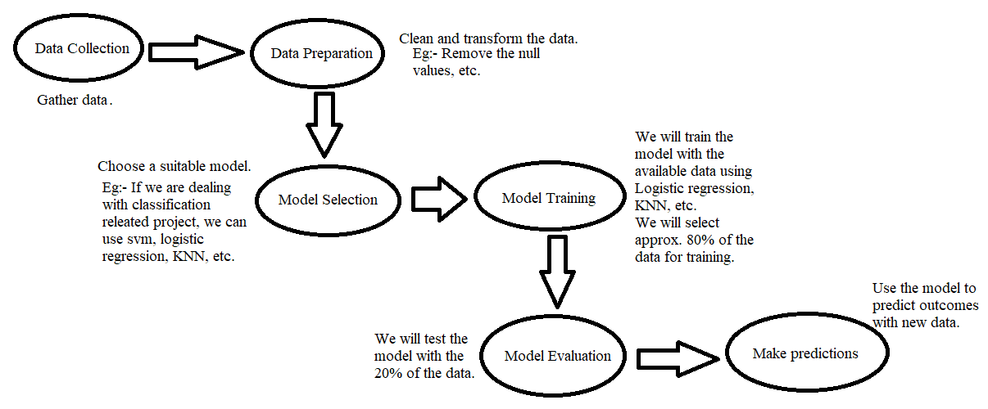
Model selection and generalization

Slide 25
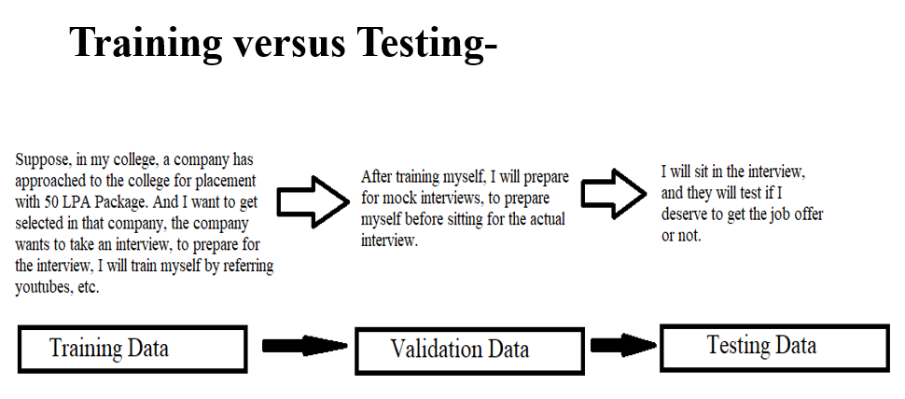

Slide 26

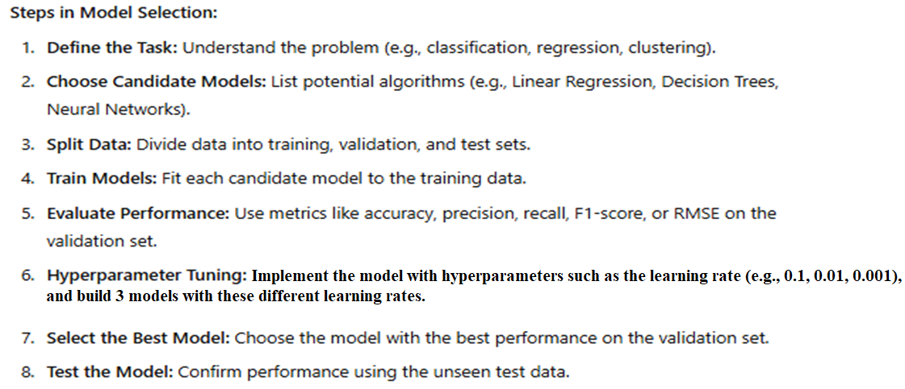

Slide 27
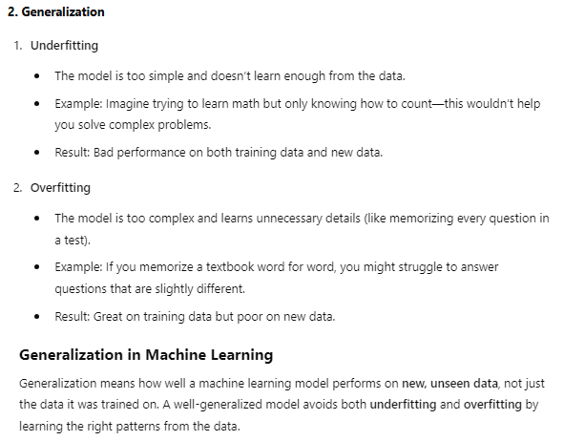

Slide 28

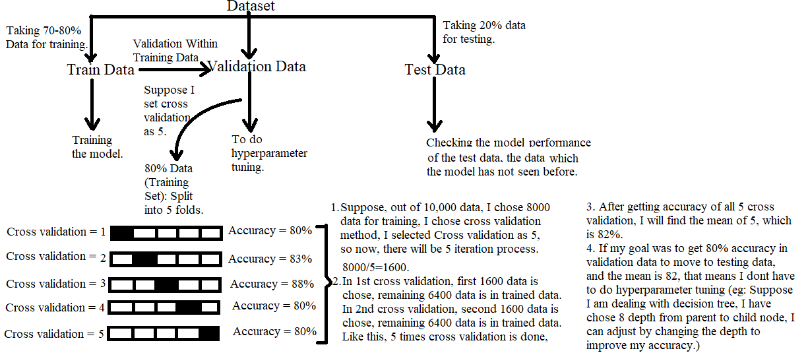

Slide 29
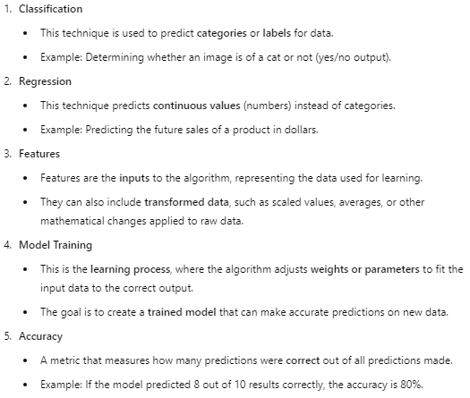
Dimensions of Supervised Learning-

Slide 30
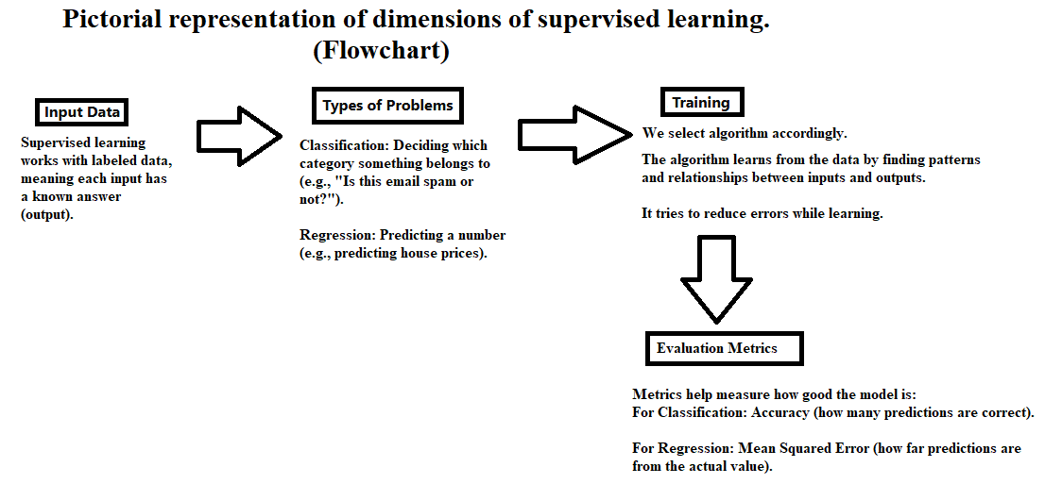

Slide 31
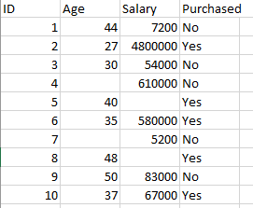
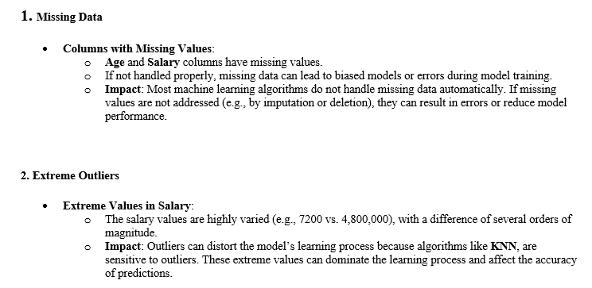
Noise

Slide 32
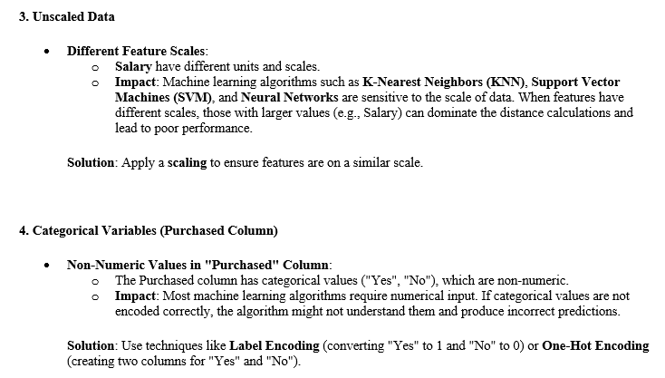

Slide 33


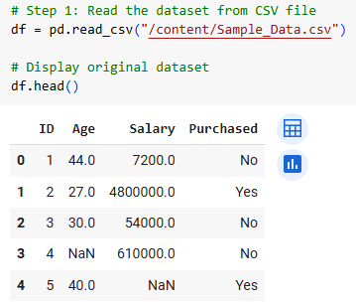
To address this:-

Slide 34
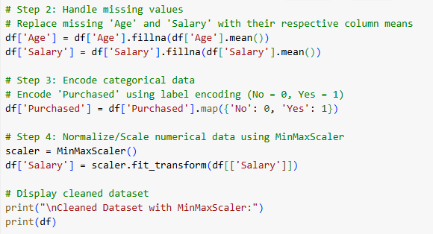
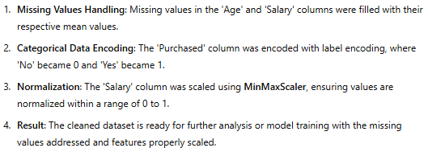

Slide 35

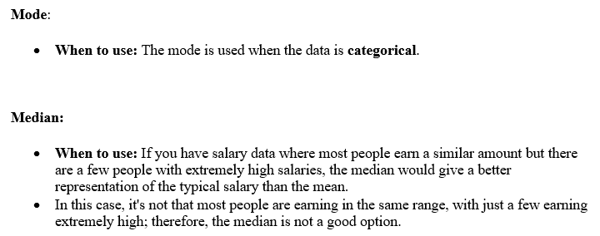

Slide 36
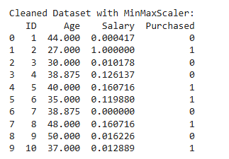
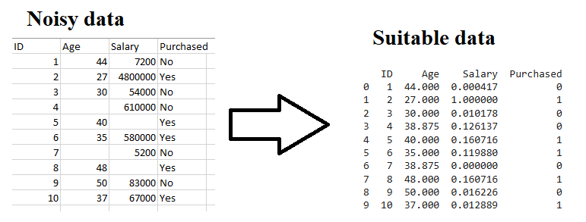
The dataset is now properly cleaned and scaled with the MinMaxScaler applied to the Salary column. The Age column is unchanged, and the Purchased column is encoded with numerical values (0 and 1). The data is now in a format suitable for training machine learning models
Link:- https://colab.research.google.com/drive/15yBLXX5JYZMkgs5IgYXJ-zgsZkSo-Pd4?usp=sharing

